Slide 1
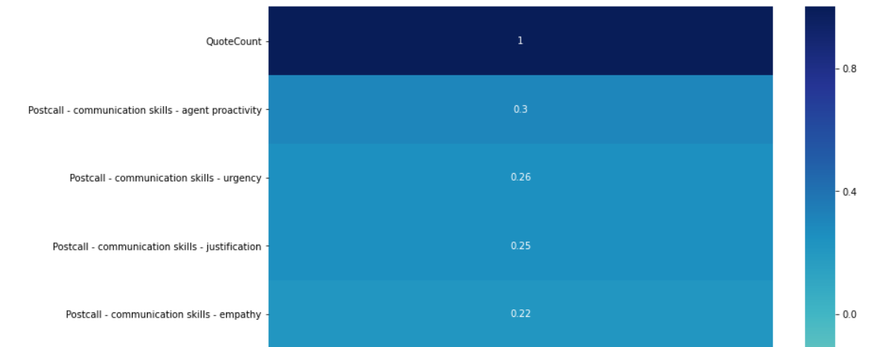
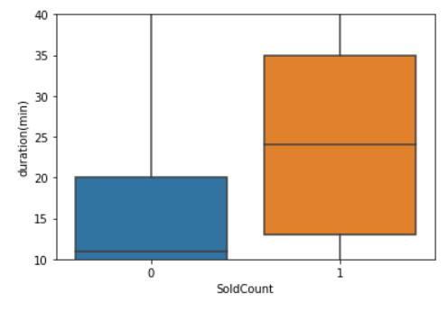
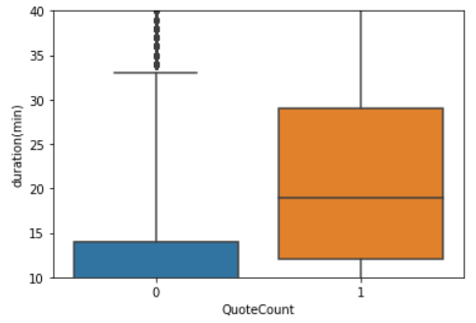
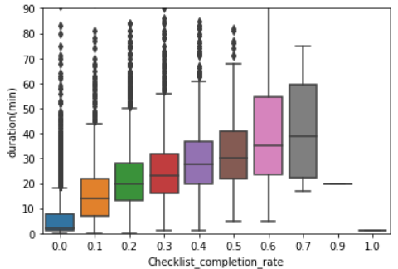

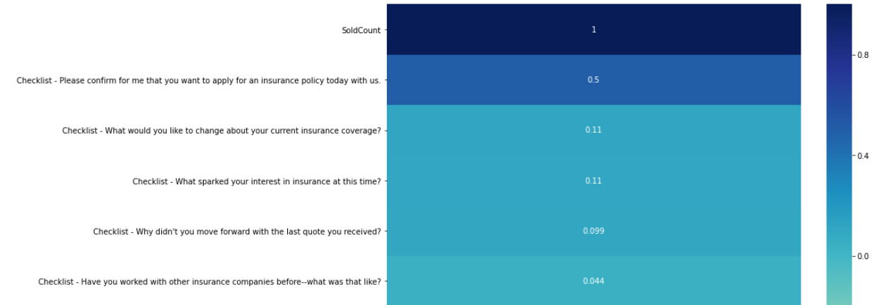
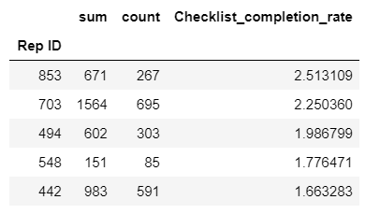
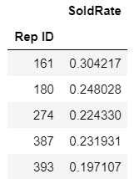
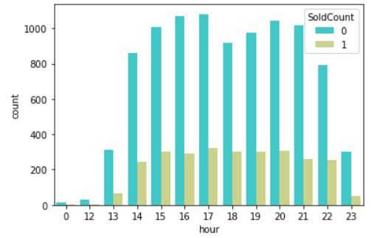
ABC Call Centre Analytics
Bonny Joseph
Abstract
Call center analytics is useful for enhancing customer experience and improving sales. ABC’s call analytics software sits in the background while call reps make calls. It records a range of metrics can be used later to evaluate Call Reps performance. For e.g. alerting Reps with the best things to say in the moment.
Objective: Find the factors responsible affecting Checklist completion, Quotes Count and Sold Count
Limitations: The data provided was for roughly 3 months
INSIGHTS
Post call
Win Percentage
16.77%
Duration
Duration is the most significant feature. As the Call rep engages more, the Checklist completion, Quote Count, and Sold Count increases
Agent Proactive communication and urgency leads the way in both cases
Checklist questions
Day of week
Cramer’s V test correlation = 4%
There is no correlation between day of week. Hence complete your calls asap. Don’t keep it for specific days thinking that it would be Win situation
Urgency was major influencer in Sold Count. Questions about present interest and previous quote rejection also had positive impact
Dataset
There were 12132 rows and 23 columns
The main columns in dataset were Rep Id, time of call, Checklist questions, post call metrics given by ABCs analytics software, Quote count and Sold Count
Top 5 Rep
Hour of call
KPI
Checklist completion rate = (# of checklist items with a 1 / total # of checklist items)
Sold Count
Quote Count
From 12-2 pm and from 11pm-12 am there seems to be very few calls. Call Reps should try to increase their call during this period.
Rep Id 161 was best when Sold Rate was considered. Rep 161 demonstrated the significant features like proactive and urgency. Low performers would need to to learn the traits from top performers

